Slide 1
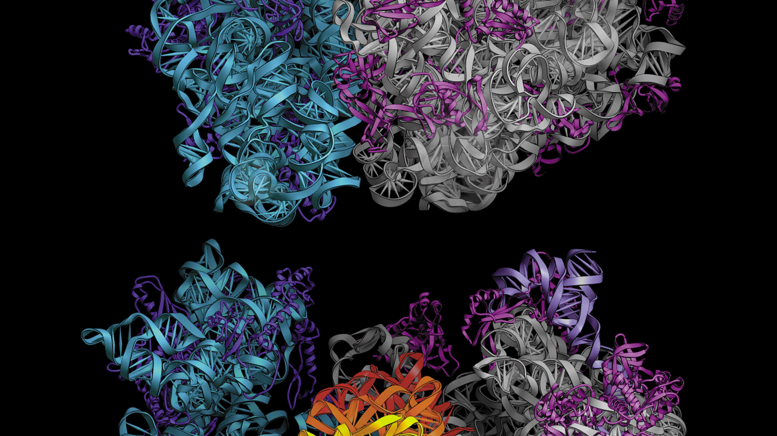
Inhibition of bacterial growth by antibiotics
Laboratoire Gulliver ESPCI
https://doi.org/10.48550/arXiv.2501.02944
Barnabe Ledoux
David Lacoste

Slide 2
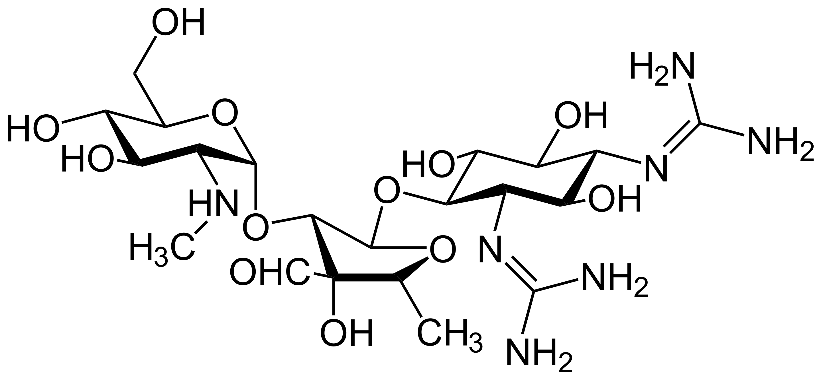
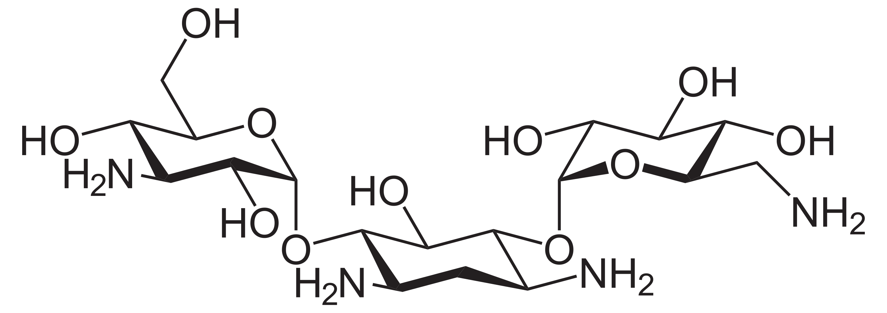
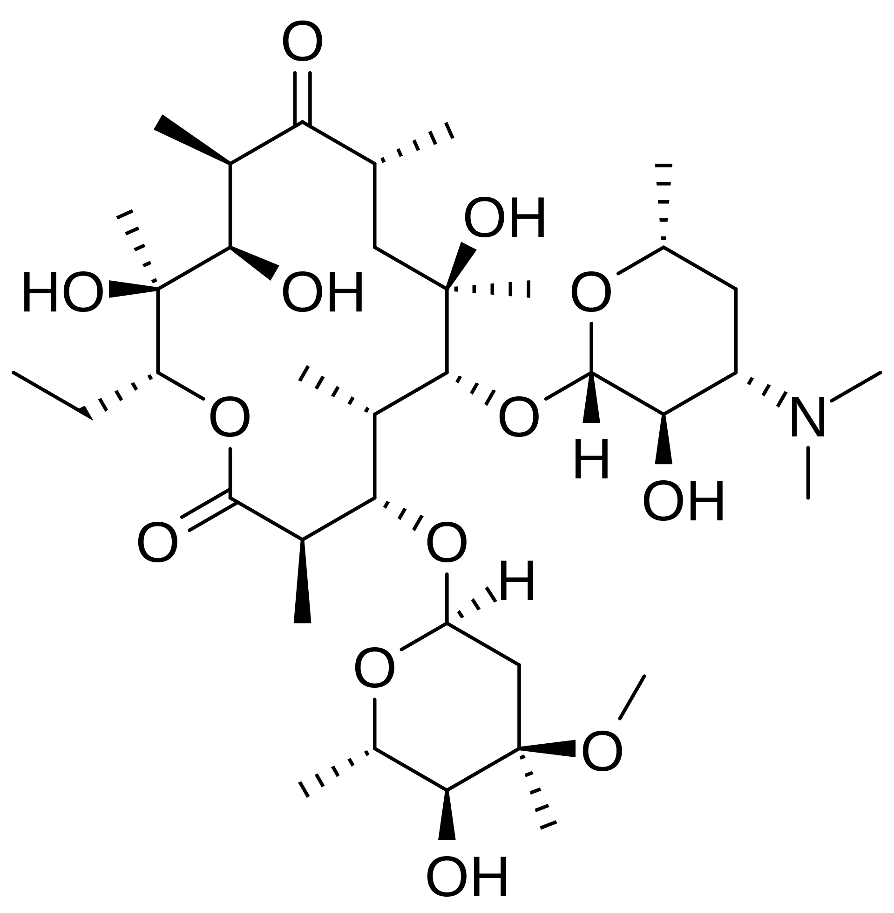
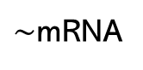
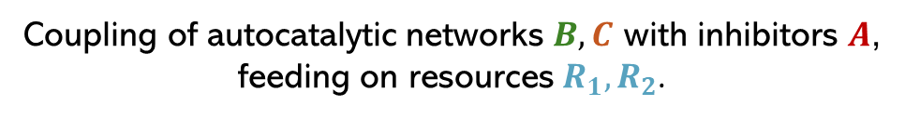

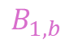

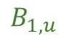


Context: Autocatalytic cycles under environmental constraints
Inhibitors (antibiotics)
autocatalysts (ribosomes)
Ribosome-targeting drugs
Inhibited autocatalysts
Streptomycin
$∼$Proteins
$$A$$
$$P_{out}$$
$∼$mRNA
Kanamycin
$$B_{1,u}$$
$$P_{in}$$
Erythromycin
$$B_{1,b}$$
Coupling of autocatalytic networks $B, C$ with inhibitors $A$, feeding on resources $R_{1},R_{2}$.
2

Slide 3
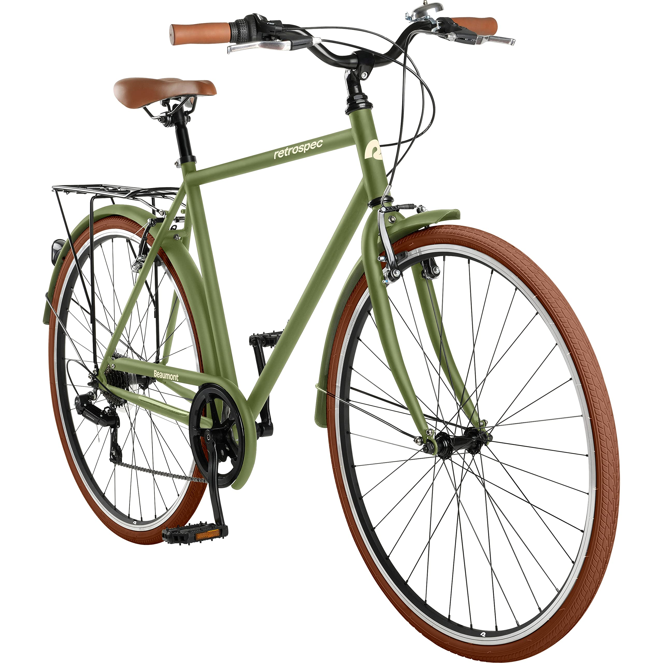
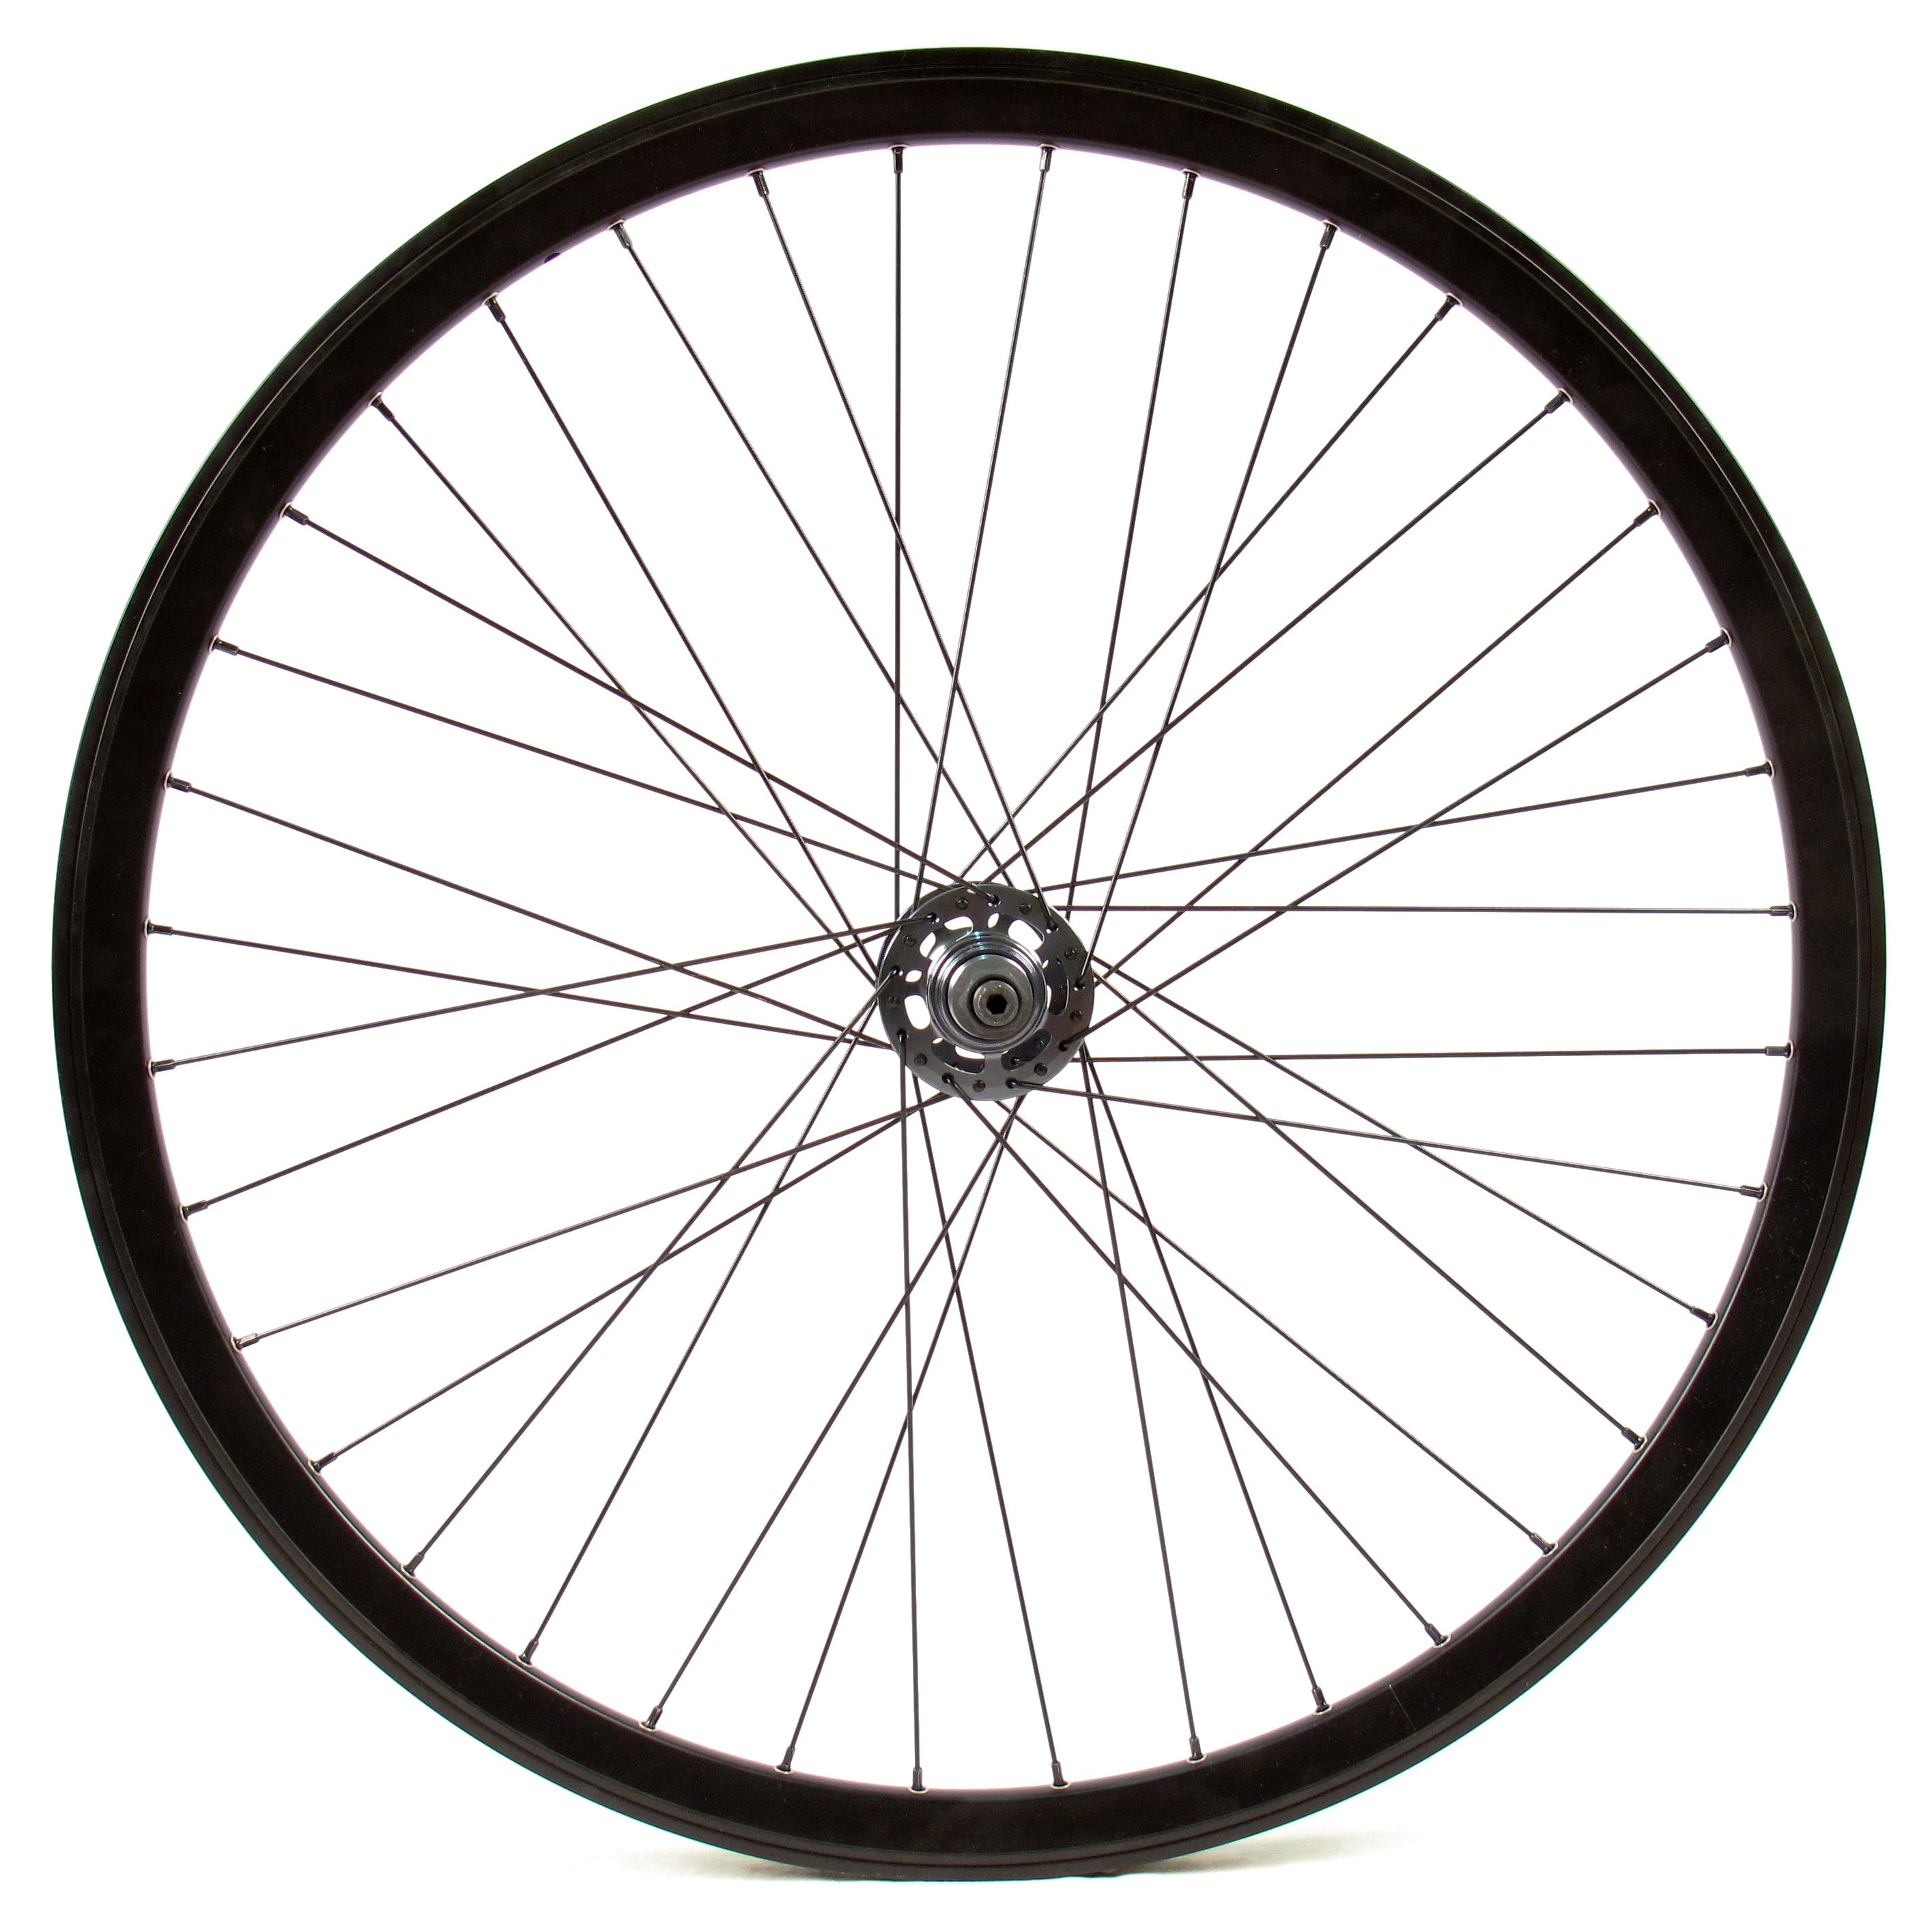
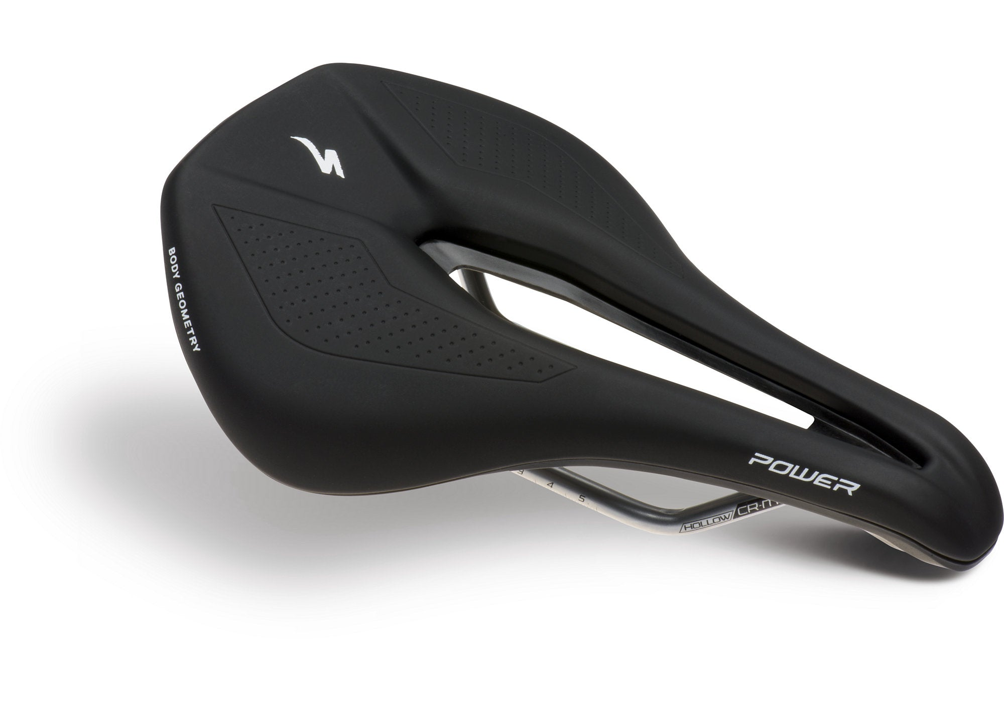
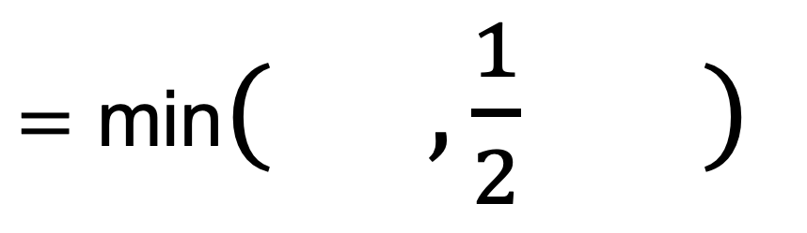
Description : Coupled autocatalytic cycles
$=$ min$( , \frac{1}{2} )$
Ribosome cycle
RNA Polymerase cycle

Slide 4
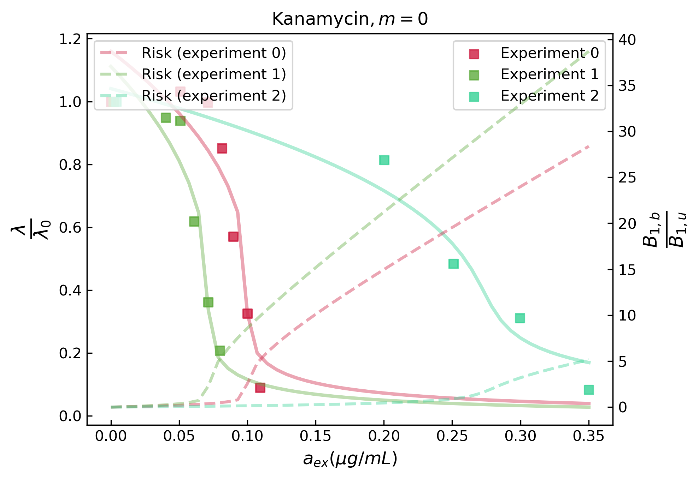
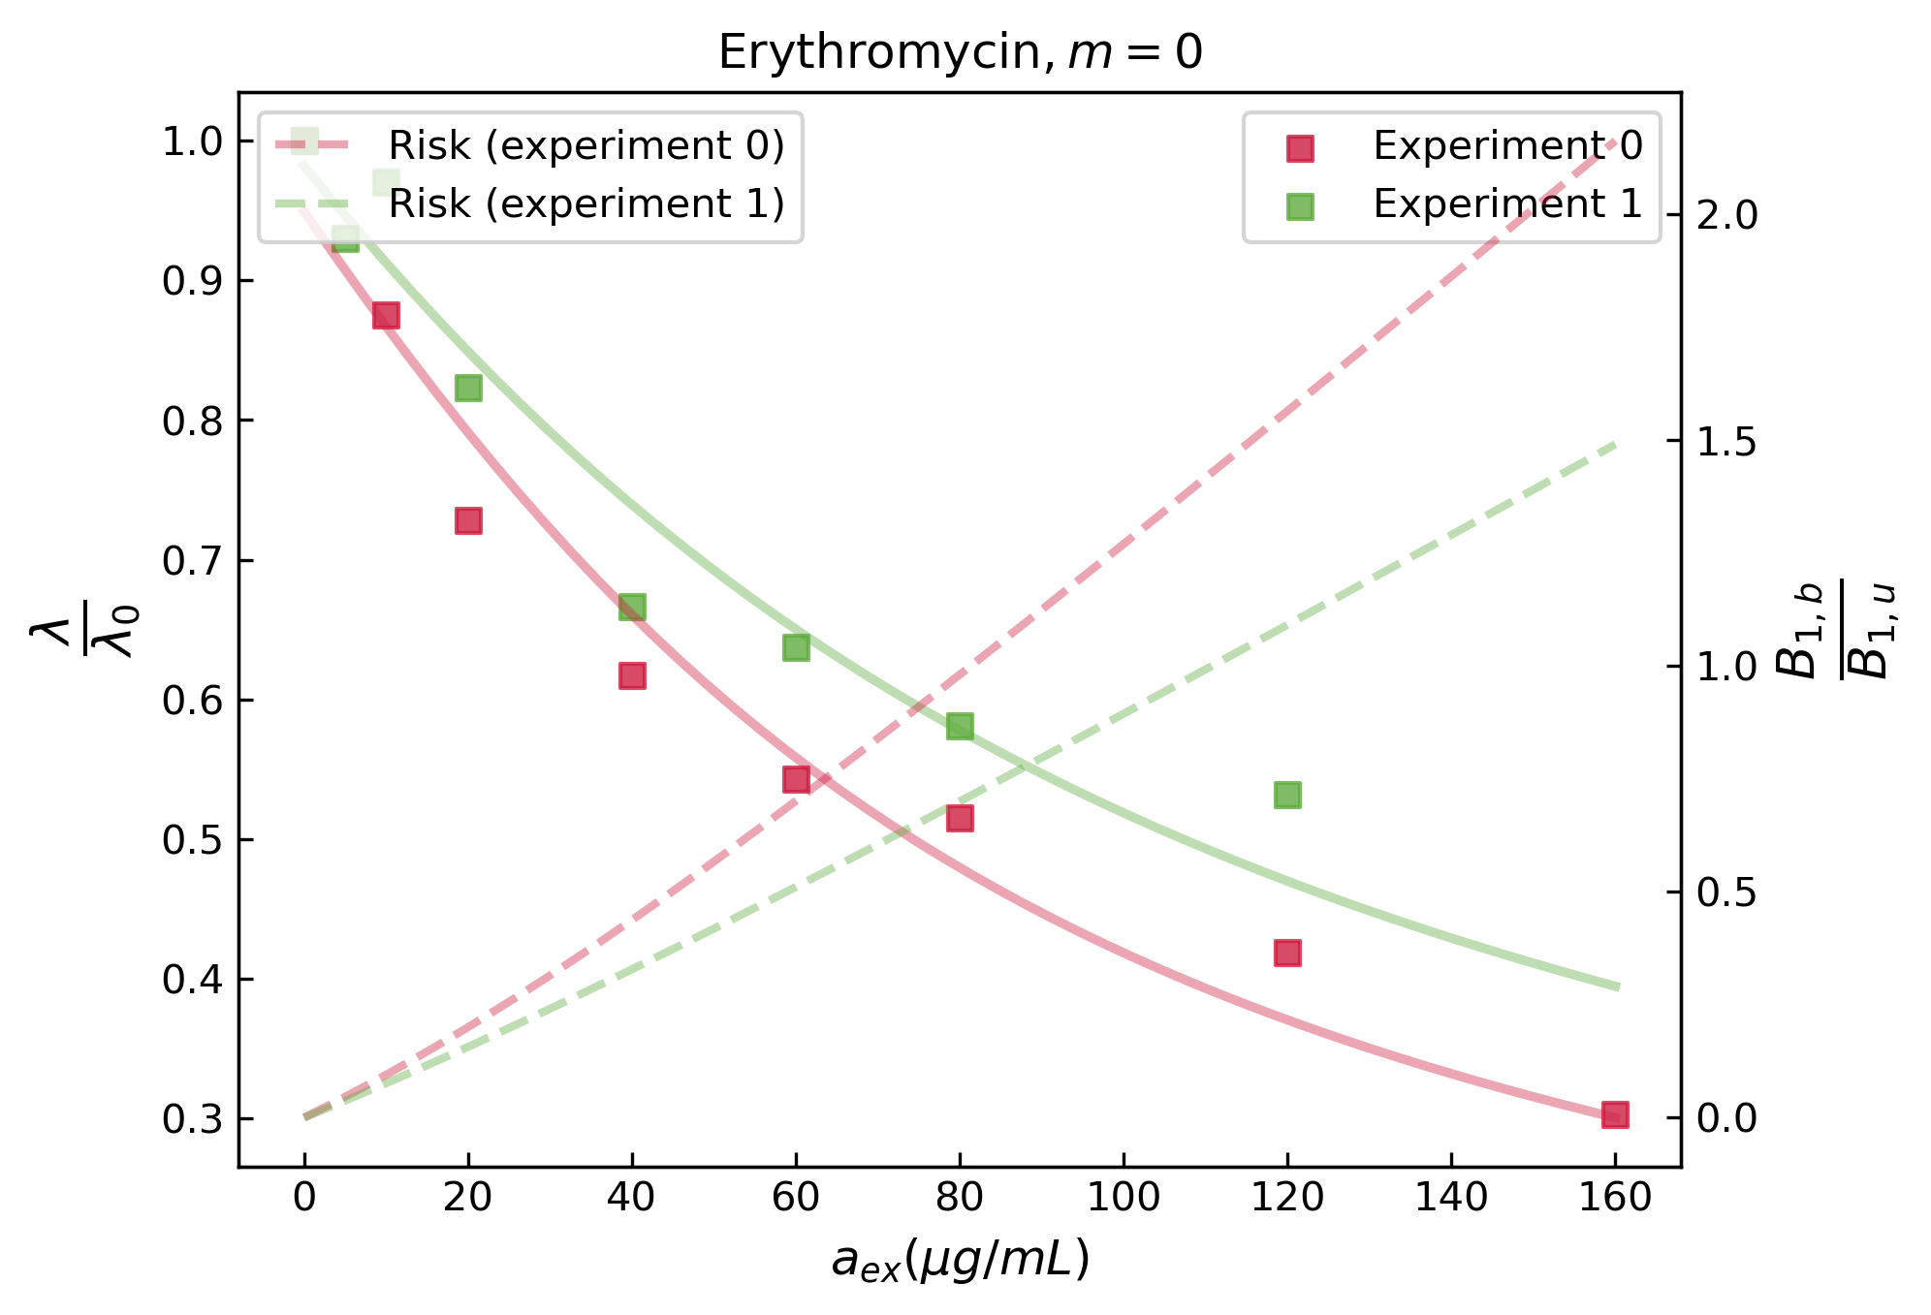
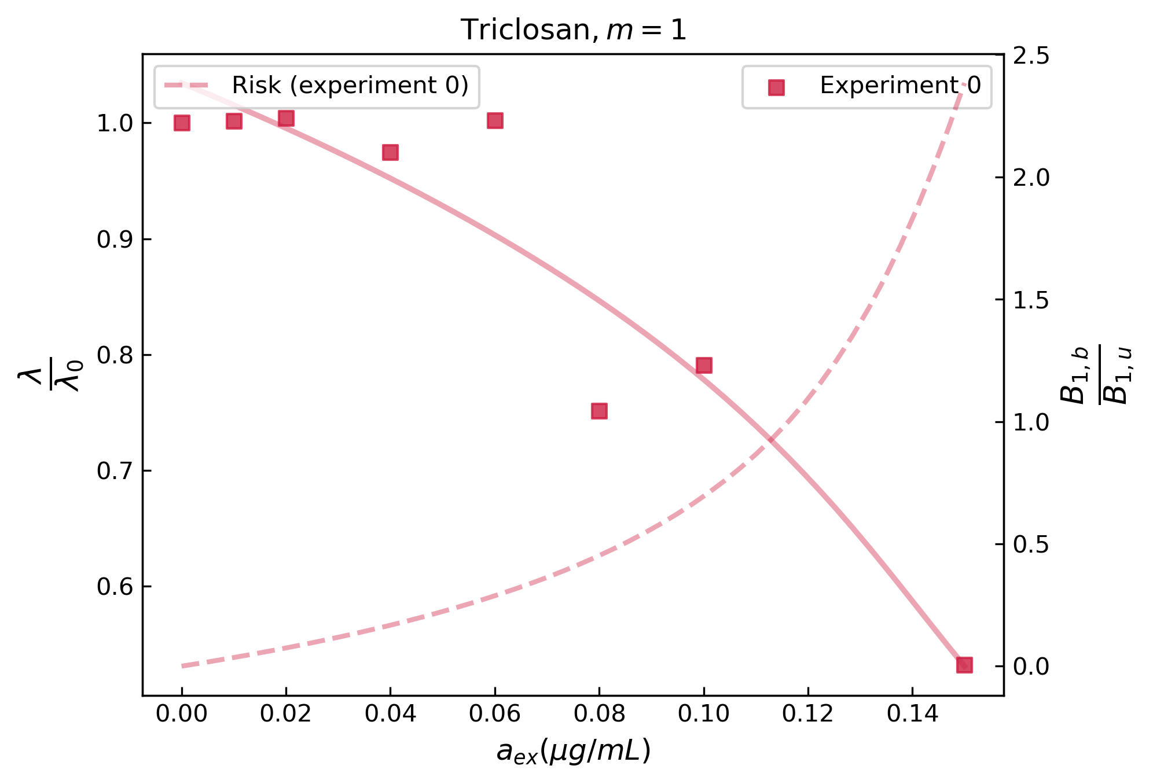
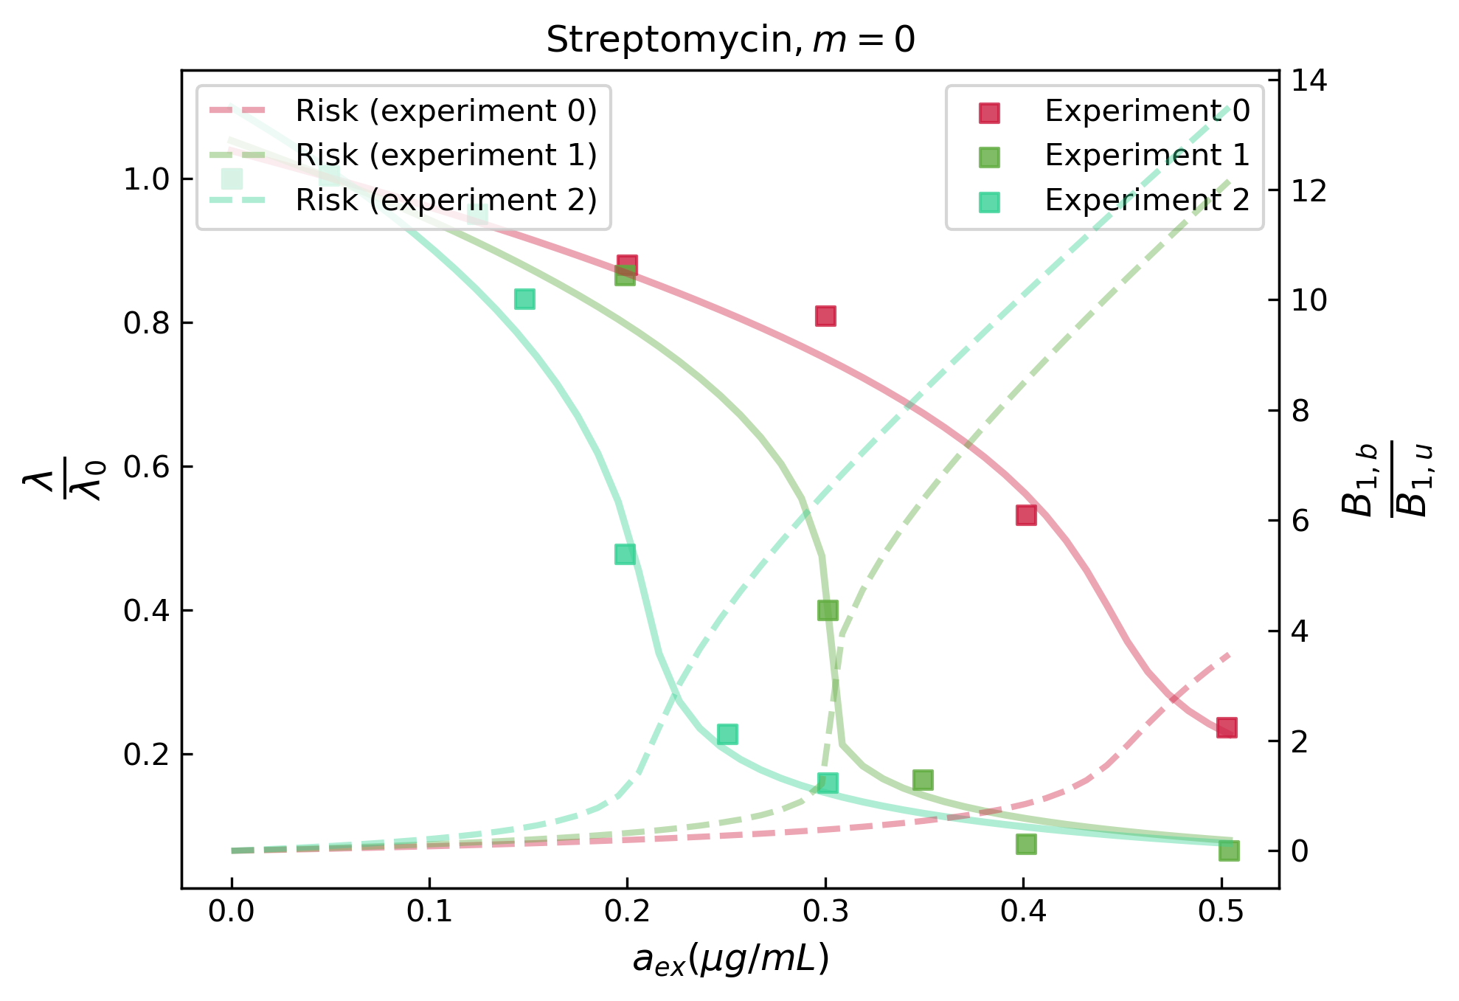
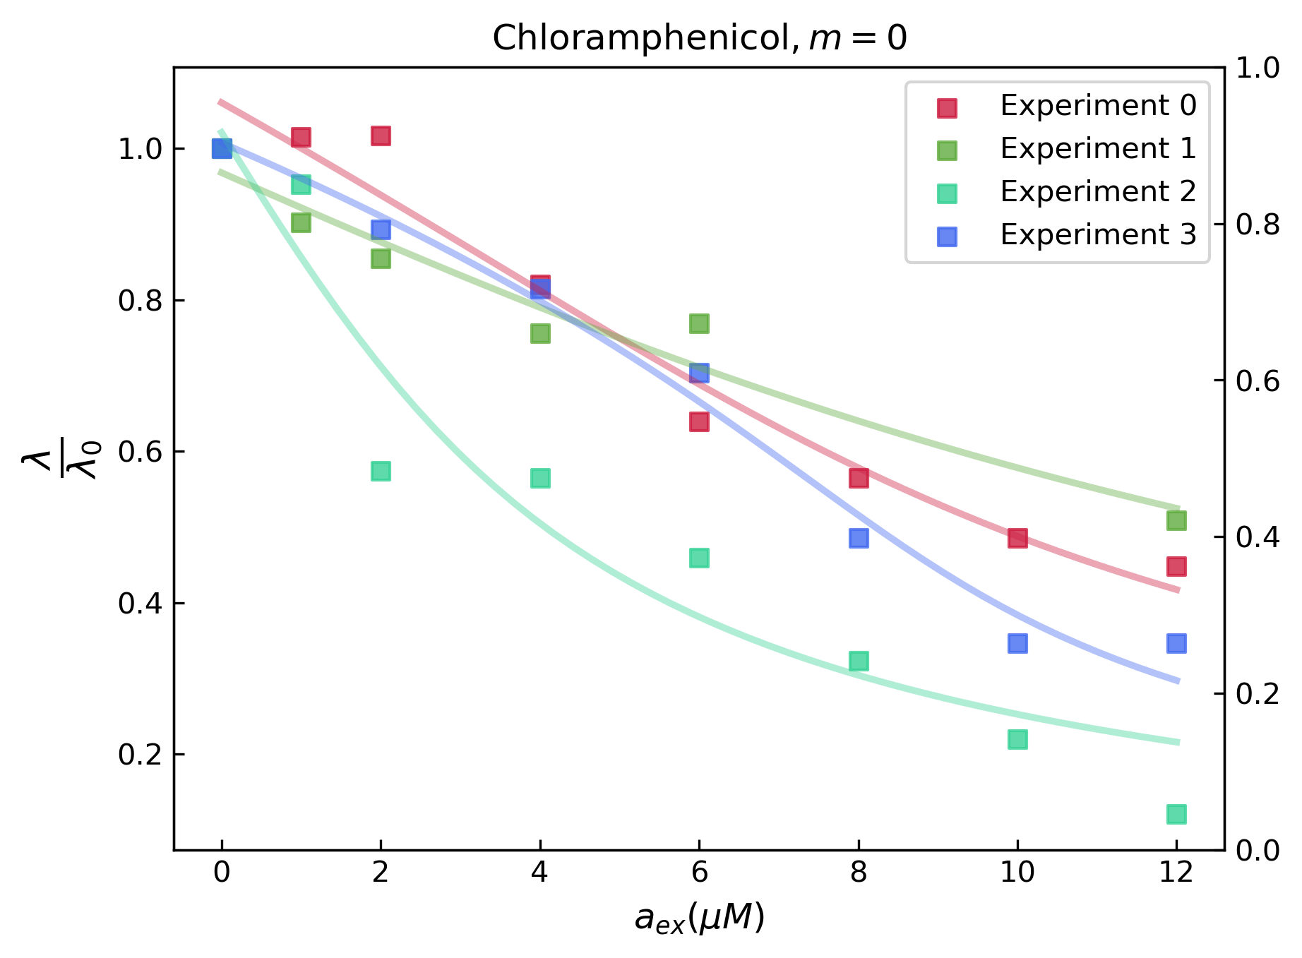
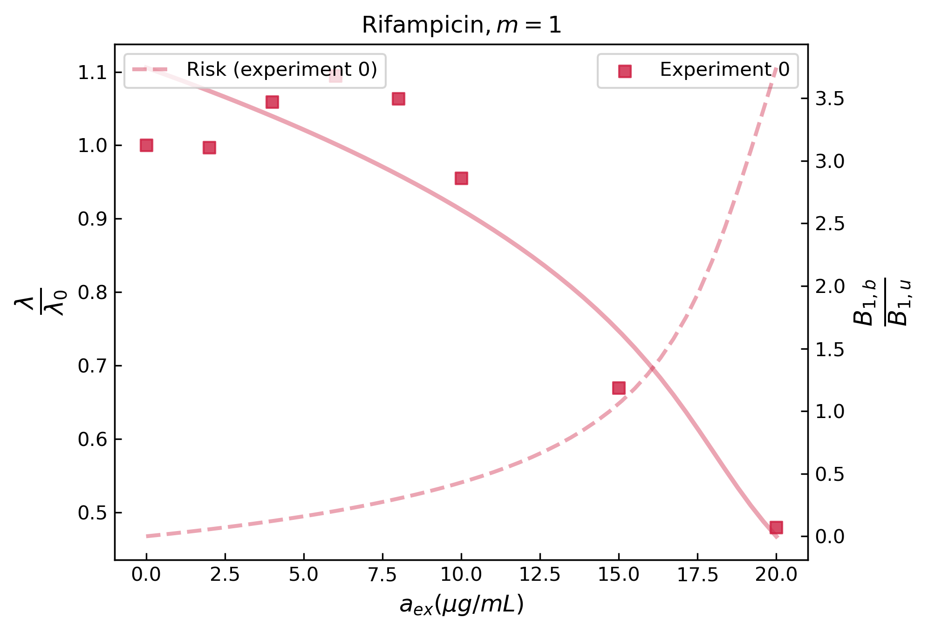
Results for intracellular autocatalytic cycles inhibitors
“Invariance of Initiation Mass and Predictability of Cell Size in Escherichia coli”
Si 2017
Ribosome targeting drugs
Drugs targeting different autocatalytic cycles
4

Slide 5
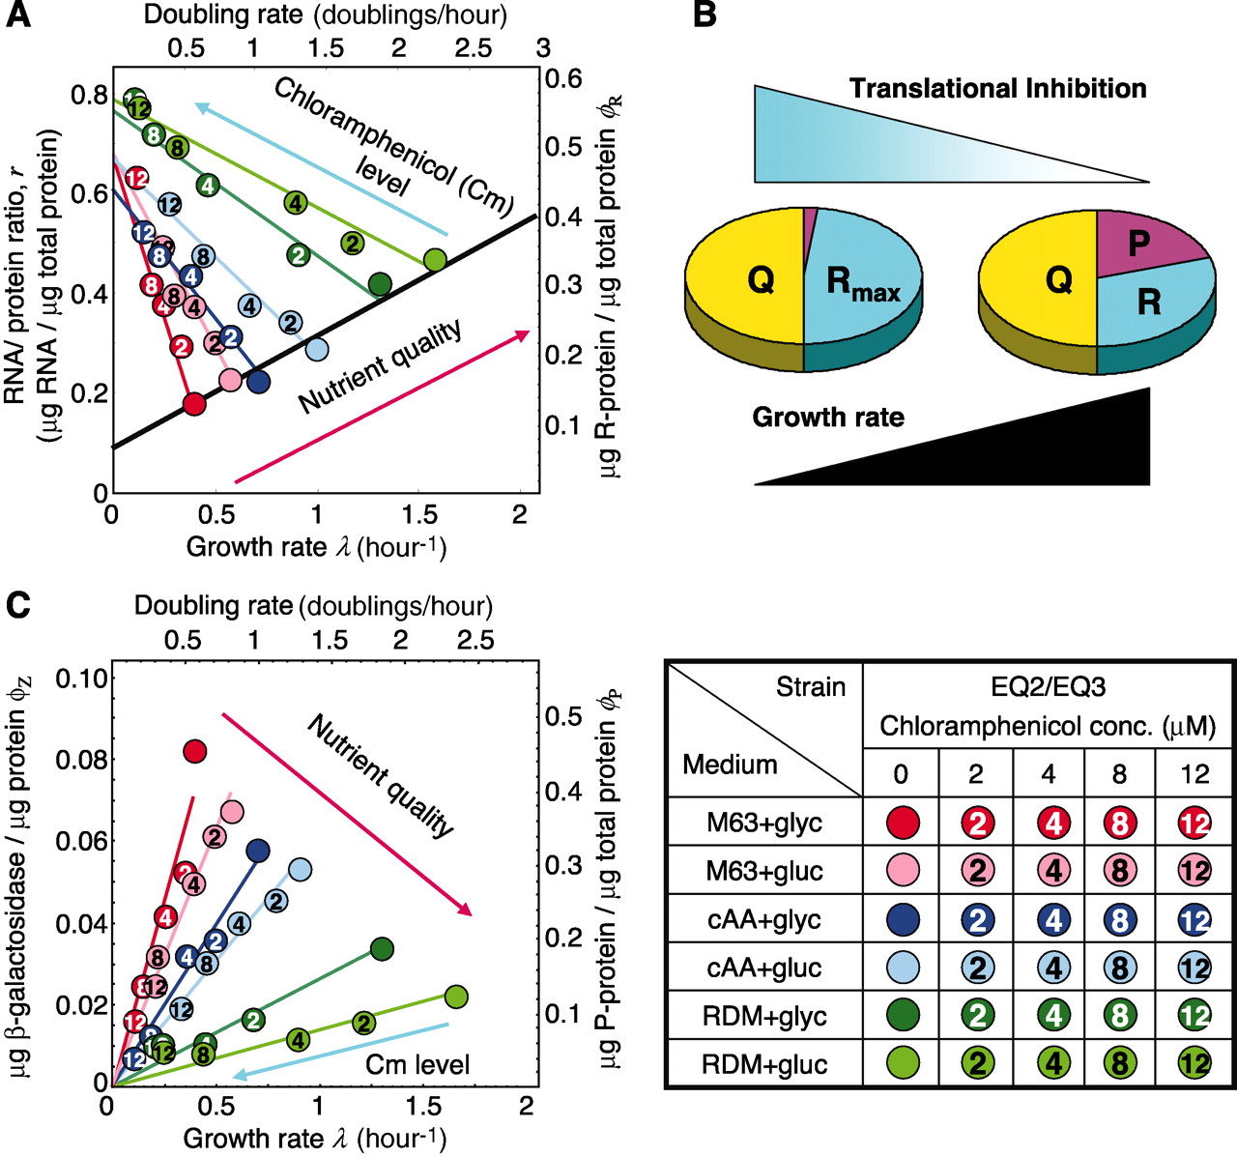
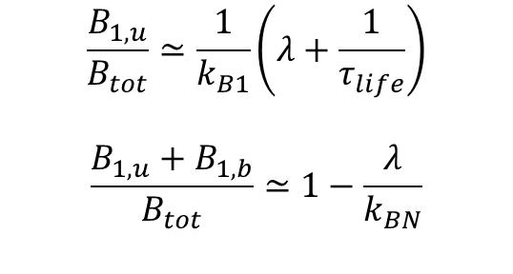
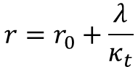
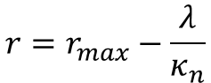
Mathematical description: Growth laws
“Interdependence of Cell Growth and Gene Expression: Origins and Consequences”
Scott 2010
“Growth-dependent bacterial susceptibility to ribosome-targeting antibiotics”
Greulich 2015
Phenomenological growth laws:
$$r=r_{0}+\frac{λ}{κ_{t}}$$
$$r=r_{max}−\frac{λ}{κ_{n}}$$
First growth law
$$\frac{B_{1,u}}{B_{tot}}≃\frac{1}{k_{B1}}\left(λ+\frac{1}{τ_{life}}\right)$$
$$\frac{B_{1,u}+B_{1,b}}{B_{tot}}≃1−\frac{λ}{k_{BN}}$$
Second growth law
5

Slide 6
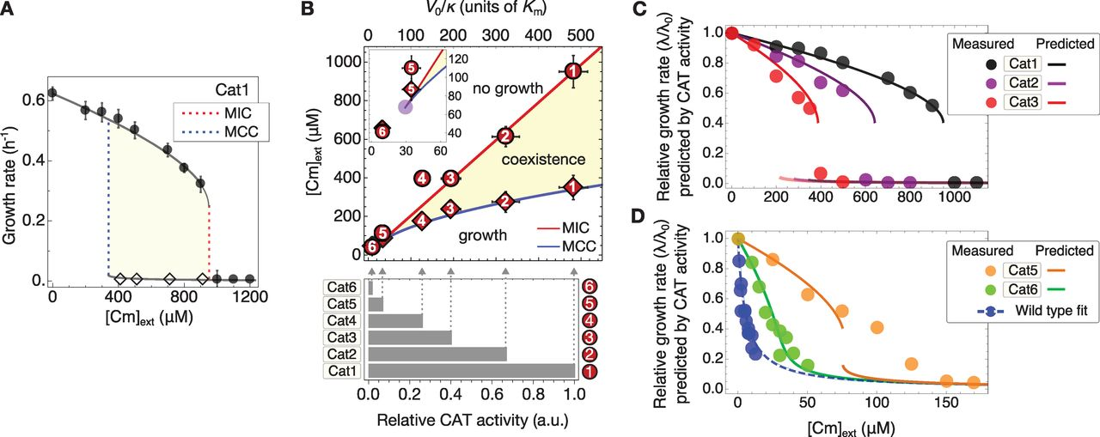
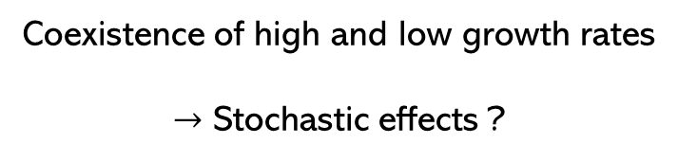
Growth rate $λ$ : Hysteresis
Coexistence of high and low growth rates
$→$ Stochastic effects ?
“The Innate Growth Bistability and Fitness Landscapes of Antibiotic-Resistant”
Deris 2013
6

Slide 7
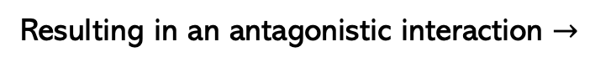
Combined effect of antibiotics
Coupled action of two antibiotics
Resulting in an antagonistic interaction $→$

Slide 8
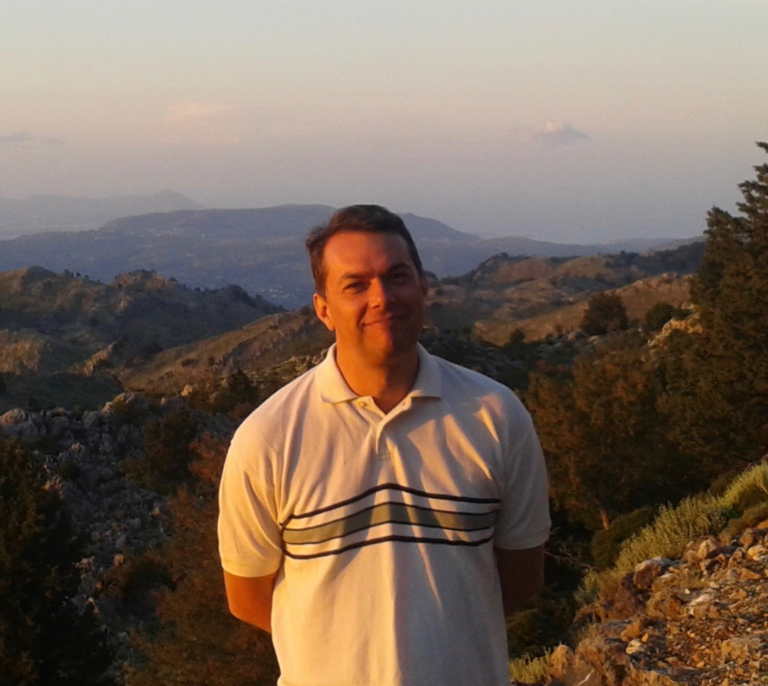
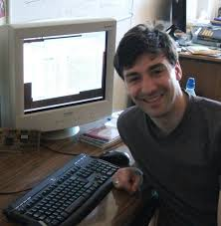
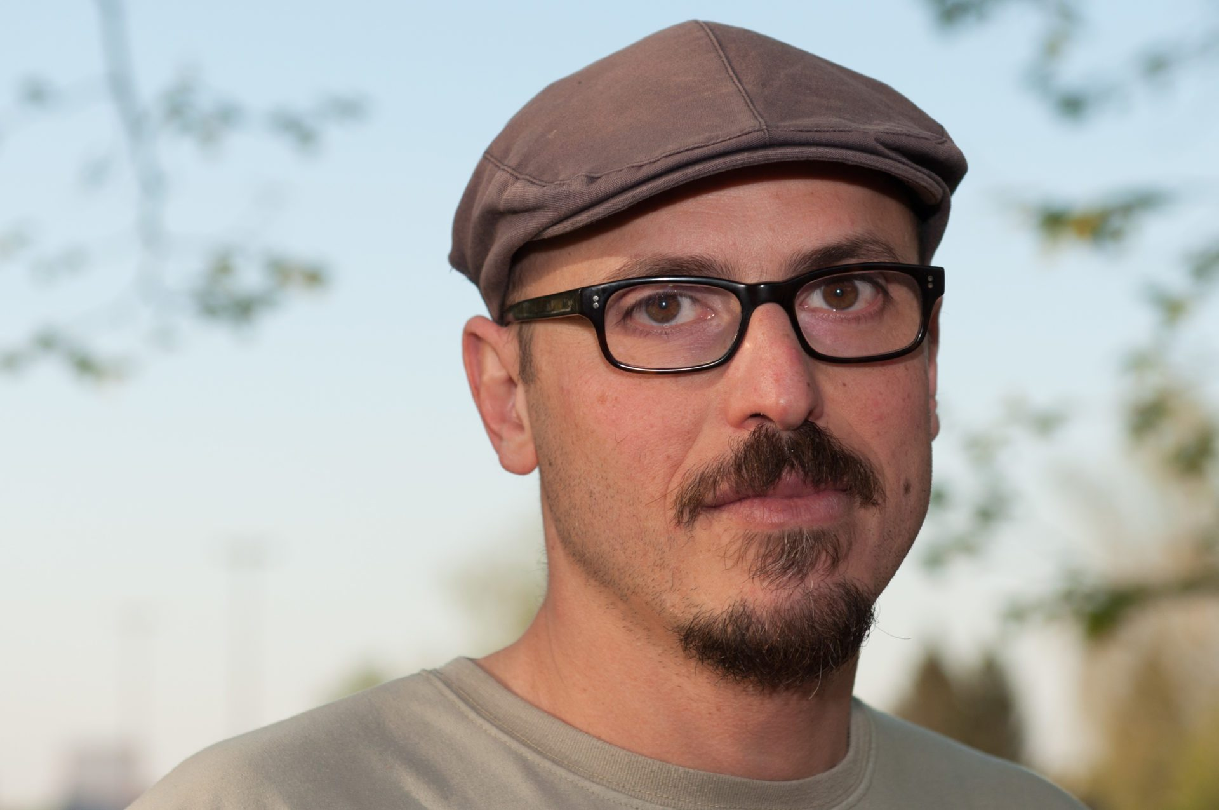
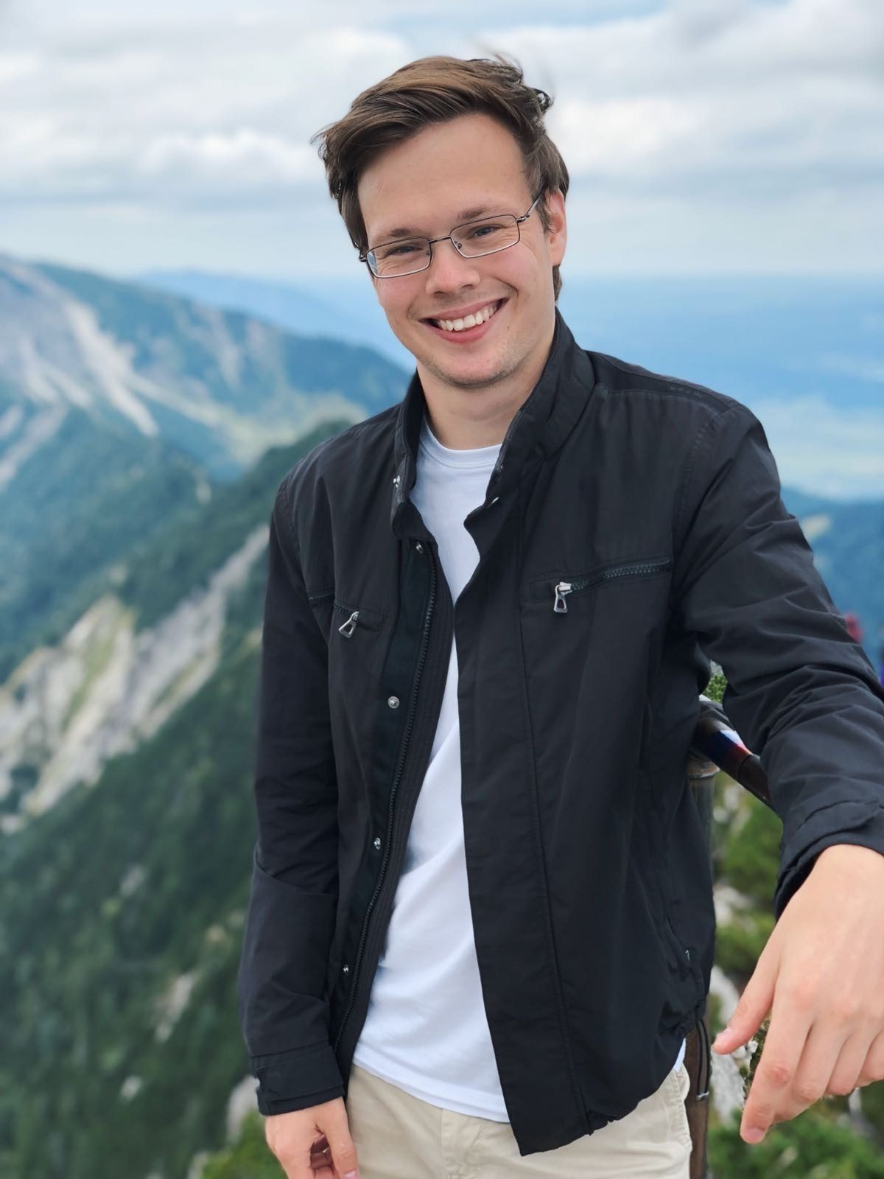
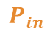

Conclusion
In this work:
We provided a formalism to describe the effect of various bacteriostatic antibiotics
We described autocatalytic networks targeted by external inhibitors
We explored several extensions allowed by this formalism
$$P_{out}$$
$$P_{in}$$
https://doi.org/10.48550/arXiv.2501.02944
Aknowledgments:
David Lacoste
(supervisor)
Luis Dinis
Charles Baroud
Institut Pasteur
Erik Maikranz
Institut Pasteur
8

